Slide 1
MATLAB for image processing Session 4: Figures and plotting

Slide 2
Course structure
Session 1
Introduction to MATLAB
Data types
Conditional statements and loops
Session 3
Advanced data structures
Object-oriented programming
Advanced image reading (Bio-Formats)
Session 2
Arrays and matrices
Image processing
Session 4
Figures and plotting
Designing a user interface

Slide 3

Under construction!
Comments/requests?
Let me know!
stephen.cross@bristol.ac.uk

Slide 4
Figures
Notes:
Convert this into 2 spider diagrams if there’s time

Slide 5
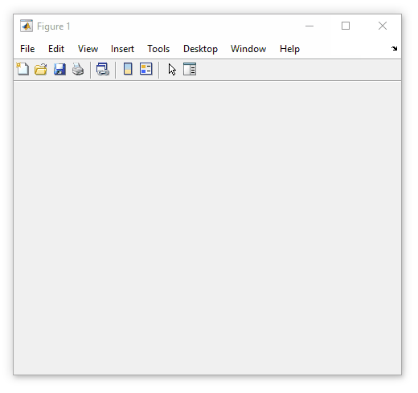
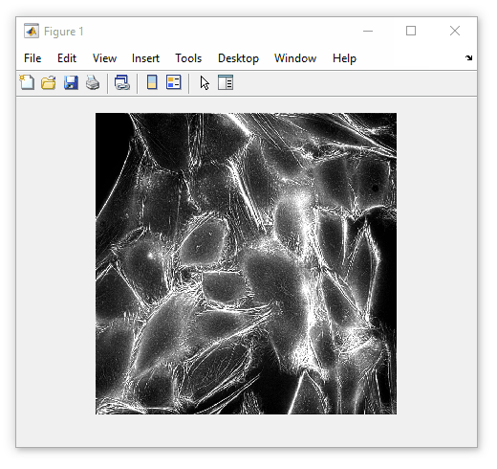
Introduction to figures
All graphical components live within a figure
The figure object is simply a container window
A figure is an object (Session 3)
Properties include
Name (title)
Position
Methods include
delete (close window)
We’ve used figures when viewing images
my_fig = figure()
imshow(some_image, [])

Slide 6
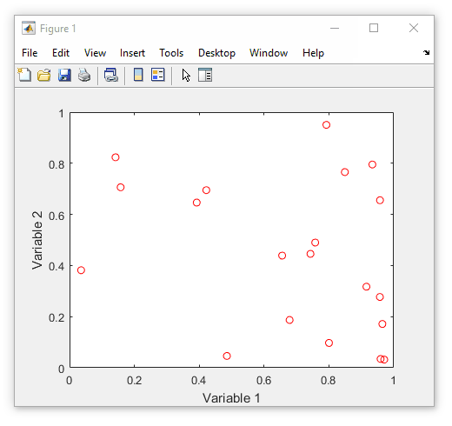
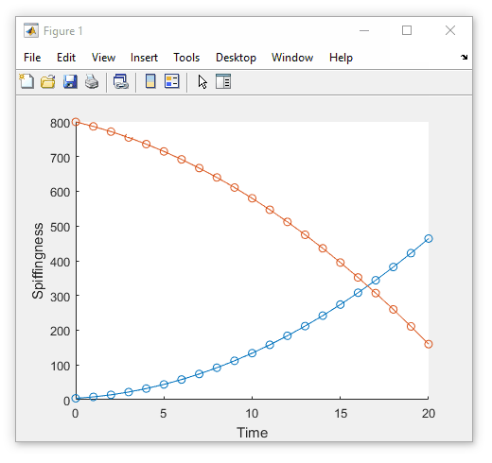
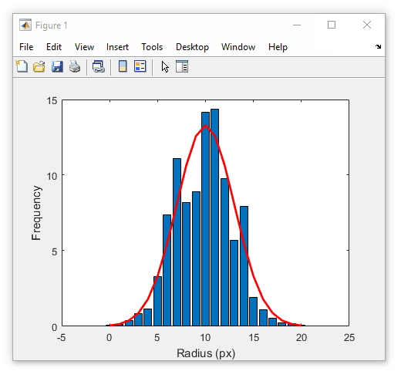
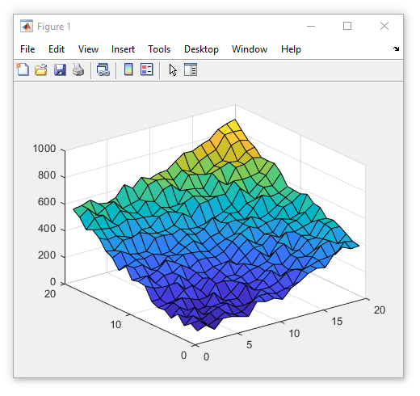
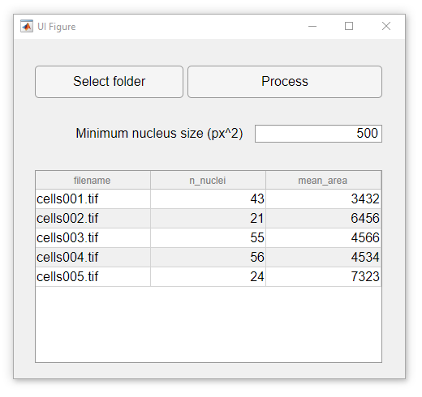
What can go in a figure?
Images
Data plots
User controls
Notes:
Figure size = [758 558 482 365]

Slide 7
Some handy figure functions
Before we go further, here are some handy commands
Get current figure (gcf)
Get a reference to the active figure
Clear current figure (clf)
Go back to a blank figure window
Close current figure (close)
Close all windows with close all

Slide 8
Plotting
Notes:
Convert this into 2 spider diagrams if there’s time

Slide 9
Already seen the figure window
This is main component of all GUI elements.
Figures are objects (as covered in Session 3). Mention some properties
List things that may go into a figure (show a few examples)
Images
Display array of pixels by their intensity
Maybe cover some extra functionality? Not sure if there’s anything particularly interesting
Plots
Drawn inside axes
Many built-in plotting types (histograms, line graphs, point graphs, 3D plots)
Would be nice to have a short video showing a 3D graph being manipulated
When talking about properties include axis labels, title, tick marks
Control elements
Buttons, sliders, menus
Can combine different elements within the same figure window
Maybe show an example window from one or two of my early programs
Talk about graphical element hierarchy (parent-child relationship)

Slide 10
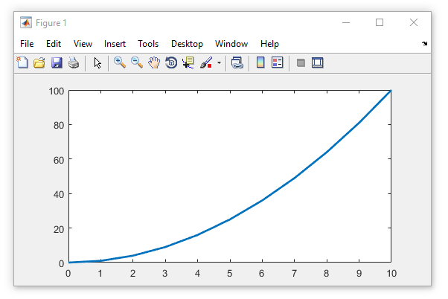
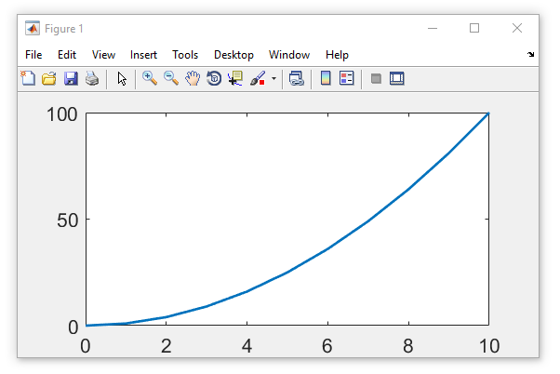
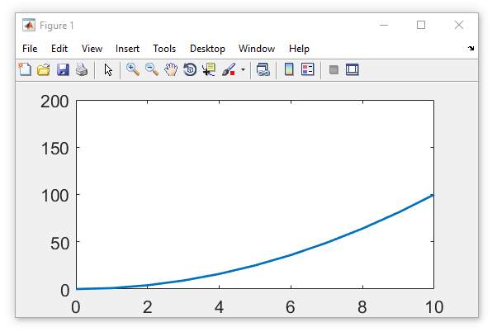
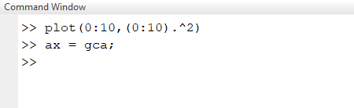
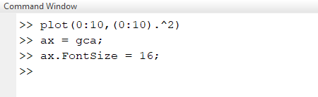
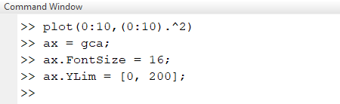
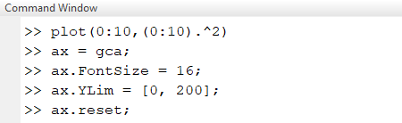
Axes
Plots are drawn inside axes
Automatically created when plotting
Get reference to active axes using gca
Axes are an object
Properties include
XLim and YLim (axis limits)
Position
Methods include
delete (remove axes)
Reset (return to default settings)

Slide 11
Scatter plots
Create a 2D scatter plot with plot
Use plot3 for a 3D scatter plot
Example using Brownian diffusion
[2D and 3D diffusion example?]

Slide 12
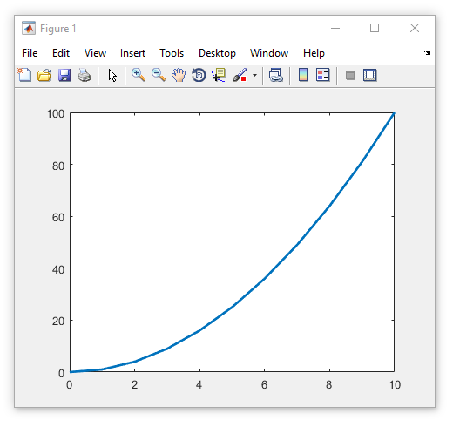
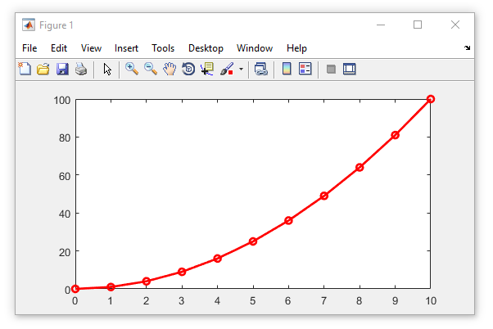
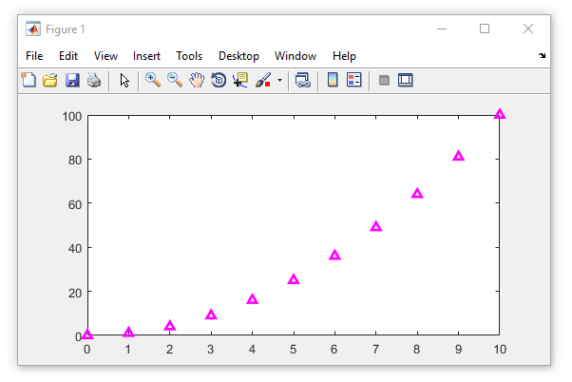
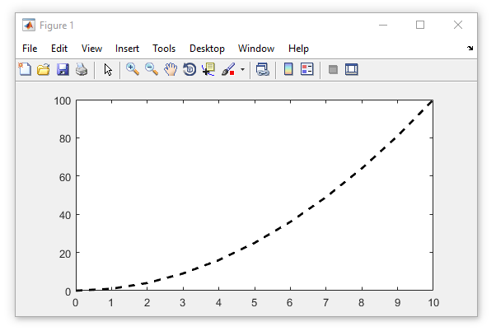
Scatter plots
String argument controls plot rendering
Only one of each (at most)
Spec. | Line style
- | Solid
-- | Dashed
: | Dotted
-. | Dash-dot
Spec. | Marker
o | Circle
+ | Plus sign
d | Diamond
s | Square
* | Asterisk
. | Point
x | Cross
^ | Triangle
Spec. | Colour
k | Black
w | White
r | Red
g | Green
b | Blue
y | Yellow
m | Magenta
c | Cyan
plot(0:10, (0:10).^2, ‘--k’)
plot(0:10, (0:10).^2, ‘m^’)
plot(0:10, (0:10).^2)
plot(0:10, (0:10).^2, ‘ro-’)

Slide 13
Histograms
sfsdfsfd
[Example 2D and 3D scatter plots]

Slide 14
Box and whisker plots
sfsdfsfd
[Example 2D and 3D scatter plots]

Slide 15
Surface plots
sfsdfsfd

Slide 16
Combining plot types
sfsdfsfd
[Example 2D and 3D scatter plots]

Slide 17
Talk about plotting
Talk about main concepts using scatter plot
Changing line properties
Changing marker types
The shorthand colour names (‘b’,’g’,’k’, etc.)
Using hold on and hold off to add elements to a plot

Slide 18
Designing a user interface
Notes:
Convert this into 2 spider diagrams if there’s time

Slide 19
Introduction GUIs
Why would we want them
What sort of thing could they include
Talk about adding control elements to GUIs in the context of a simple push button
Callback functions
Enable/disable
Visible/not visible
Don’t use GUIDE
This will be removed from MATLAB in the future

Slide 20
Questions?!
Notes:
Convert this into 2 spider diagrams if there’s time

Slide 21
Under construction!
Comments/requests?
Let me know!
stephen.cross@bristol.ac.uk

